Slide 1
ADO.NET
Shahram Ramezani
MFT
shahram.ramezani@gmail.com

Slide 2
Introduction
Data Providers
  Connection
  Command
  DataAdapter
  DataReader
DataSet
Demo
XML Support
Best Practices

Slide 3
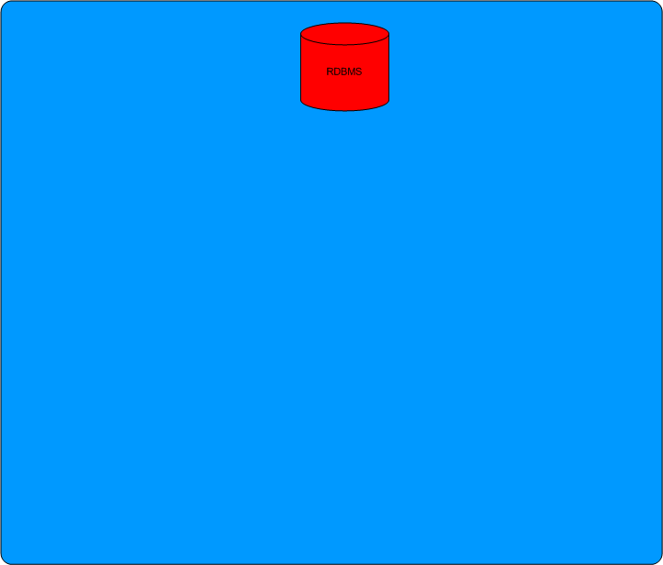

Slide 4
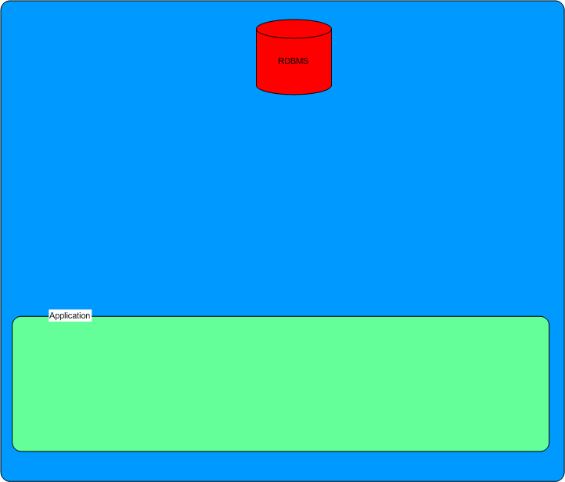

Slide 5
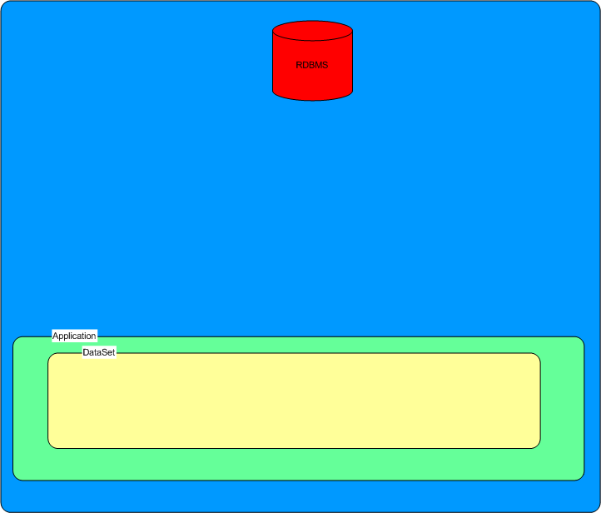

Slide 6
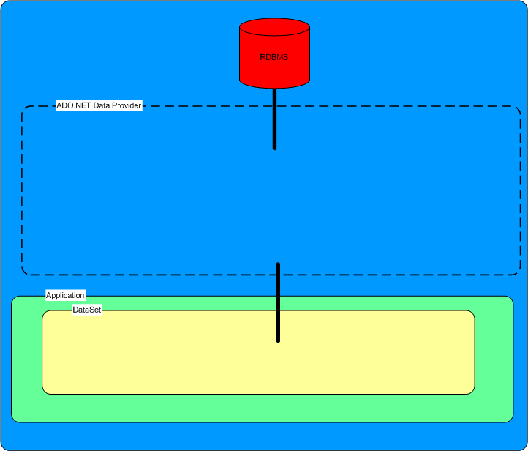
Data Providers that come with ADO.NET:
SqlClient
OracleClient
OleDb
ODBC
SqlServerCE
System.Data.SqlClient
System.Data.OracleClient
System.Data.OleDb
System.Data.Odbc
System.Data.SqlServerCe

Slide 7
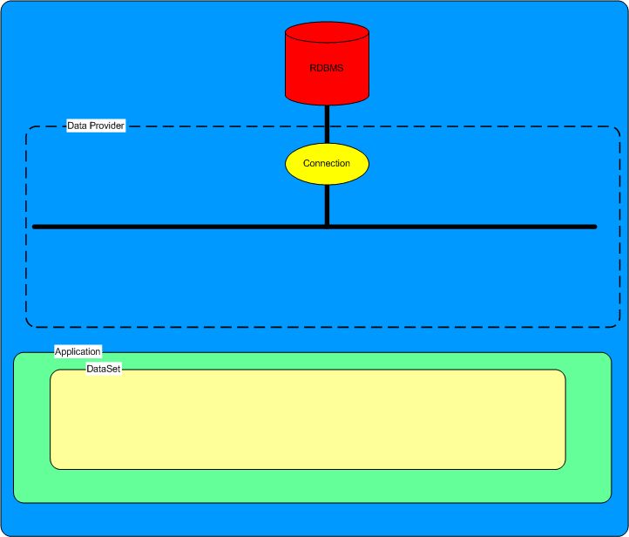

Slide 8
System.Data.SqlClient.SqlConnection
System.Data.OracleClient.OracleConnection
System.Data.OleDb.OleDbConnection
System.Data.Odbc.OdbcConnection
System.Data.SqlServerCe.SqlCeConnection
All inherit from Component
All implement System.Data.IDbConnection

Slide 9
IDbConnection
ConnectionString
ConnectionTimeout
Database
State
  Open
  Closed
Open
Close
BeginTransaction

Slide 11
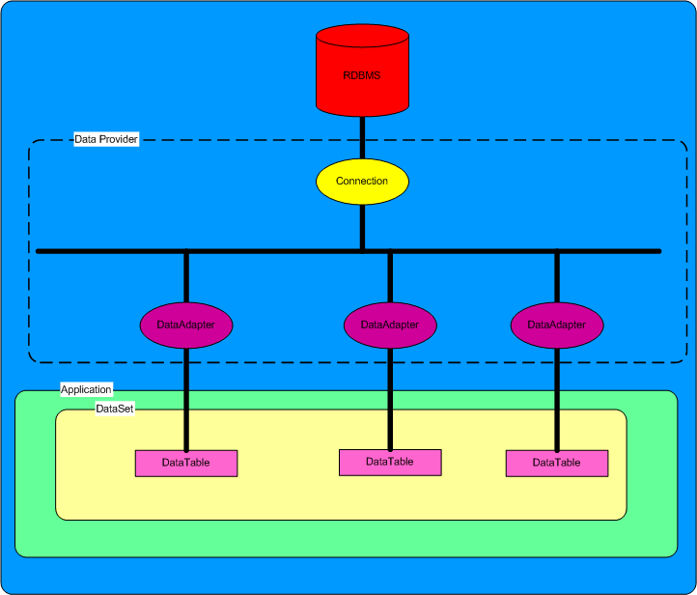

Slide 12
DataAdapter
System.Data.Common.DataAdapter
System.Data.Odbc.OdbcDataAdapter
System.Data.OleDb.OleDbDataAdapter
System.Data.OracleClient.OracleDataAdapter
System.Data.SqlClient.SqlDataAdapter
System.Data.SqlServerCe.SqlCeDataAdapter
Two Important Methods:
Fill data source ➔ DataSet
Update data source ⬅ DataSet

Slide 13
Connection
DataAdapter
DataSet

Slide 14
DataAdapter’s
TableMappings collection
DataAdapter ⬅➔ DataTable in DataSet

Slide 15
DataAdapter
4 Important Properties
SelectCommand
InsertCommand
UpdateCommand
DeleteCommand

Slide 16
Command
Represents an SQL statement
Implements IDbCommand
Properties:
public enum CommandType can be StoredProcedure Text
TableDirect
string CommandText
IDbConnection Connection
Parameters
Transaction

Slide 17
Command - Methods
ExecuteNonQuery()
ExecuteScalar()
ExecuteReader()
ExecuteXmlReader() (SqlCommand only)

Slide 18
DataReader
Provides a read-only forward-only connected stream recordset from a database.
Use when you do not want to keep the data cached in memory (use for web data binding). ➔ Low memory overhead.
Requires exclusive use of an open Connection object for the lifetime of the DataReader.
Implement IDataReader and IDataRecord

Slide 19
IDataReader
Methods
Read() Advances the IDataReader to the next record.
Close() Closes the IDataReader object
GetSchemaTable()
  Returns a DataTable that describes the column metadata of the IDataReader.
NextResult()
  Advances the data reader to the next result set , when reading the results of batch SQL statements (for example when using a stored procedure that returns multiple result sets).
DataReader can’t be created directly. Instead, an open IDataReader instance is returned from the DbCommand.ExecuteReader() method

Slide 20
IDataRecord
Provides access to the column values within each row for a DataReader.
Provides methods to return strongly typed data
myBoolean = myDataReader.GetBoolean(3);

Slide 21
Data Access Strategy
Use DataReader for:
Web Forms
Use DataAdapter – DataSet for:
Windows Forms
XML Web Services
Always consider using:
ExecuteScalar when you need only one value
ExecuteNonQuery when your interaction with the data source will not result in any returned data. For example executing a DDL statement.

Slide 22
DataSet
An in-memory representation of disconnected data
Relational – Not object oriented
Implements IListSource which allows it to provide a list for a data-binding scenario but is not actually a bindable list in and of itself
The actual bindable list is a DataView.

Slide 23
DataSet
Important Properties
Tables – a collection of DataTable objects
Relations – a collection of DataRelation objects
EnforceConstraints

Slide 24
DataTable
Properties
Columns – a collection of DataColumn objects
        represents the table’s schema
Rows – a collection of DataRow objects
  represents the table’s data
PrimaryKey
Constraints UniqueConstraint, ForeignKeyConstraint
ChildRelations
ParentRelations

Slide 25
DataRelation
Represents a parent-child relationship between two DataTable objects.
Used For:
  Enforcing Referential Integrity.
  Navigating between DataTables.
  Cascading changes made to parent row down to child rows.

Slide 26
DataRowState
Each DataRow has a RowState property of type DataRowState
public enum DataRowState
  Detached – not part of any DataRowCollection
  Added – since last call to AcceptChanges method of DataRow
  Deleted – Since last call to AcceptChanges method of DataRow
  Modified – Since last call to AcceptChanges method of DataRow
  Unchanged – Since last call to AcceptChanges method of DataRow

Slide 27
AcceptChanges, RejectChanges, and Reset Methods
AcceptChanges exits for DataSet, DataTable, DataRow
  Commits the changes
RejectChanges exits for DataSet, DataTable, DataRow
  Rollbacks all changes since last call to AcceptChanges
Reset exits for DataSet, DataTable
  Rolls back all changes since object was created

Slide 28
DataView
A view of a DataTable that can be bound to controls, filtered, and sorted.
Properties:
RowFilter string expression used to filter which rows are viewed. Uses same syntax as the WHERE clause of a SQL statement.
RowStateFilter decides which type of row to view
  Added, CurrentRows, Deleted, Modified Current
  Modified Original, None, Original Rows,
  Unchanged Rows

Slide 29
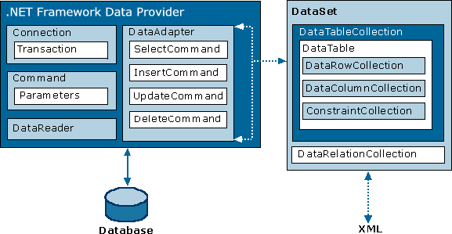

Slide 30
Thank you
Send your comments to :
Shahram.ramezani@gmail.com

